Slide 1
Secure data hiding in images using steganography
CAPSTONE PROJECT
Presented By: Dharitri Sarkar
Student Name : Dharitri Sarkar
College Name : Camellia Institute Of Engineering & Technology, Purba Burdwan
Department : Computer Science and Engineering

Slide 2
OUTLINE
Problem Statement
Technology used
Wow factor
End users
Result
Conclusion
Git-hub Link
Future scope

Slide 3
Problem Statement
Traditional encryption methods make data protection obvious, increasing the risk of interception. This project uses image steganography to hide secret messages within images using Least Significant Bit (LSB) encoding. The message remains invisible, ensuring secure and discreet communication. This approach enhances data security without attracting unwanted attention.

Slide 4
Technology used
Programming Language: Python
Libraries: OpenCV (cv2) for image processing, OS for file handling
Algorithm: Least Significant Bit (LSB) encoding for steganography
Platform: Windows
Output Format: Encrypted image (JPG) with hidden message

Slide 5
Wow factors
Invisible Encryption: Hides messages within images without altering their visible appearance.
Dual Security: Uses both steganography and password protection for enhanced security.
Lightweight & Fast: Minimal processing time with no need for large encryption keys.
Easy & Accessible: Works on any standard image, making secret communication effortless.
No Suspicion: Unlike traditional encryption, it doesn’t attract attention or look suspicious.

Slide 6
End users
Cybersecurity Professionals – For secure and discreet communication.
Journalists & Activists – To share sensitive information without detection.
Government & Military – For covert communication and intelligence sharing.
Businesses & Corporations – To protect confidential data from competitors.
General Users – Anyone needing a private and secure way to exchange messages.

Slide 7
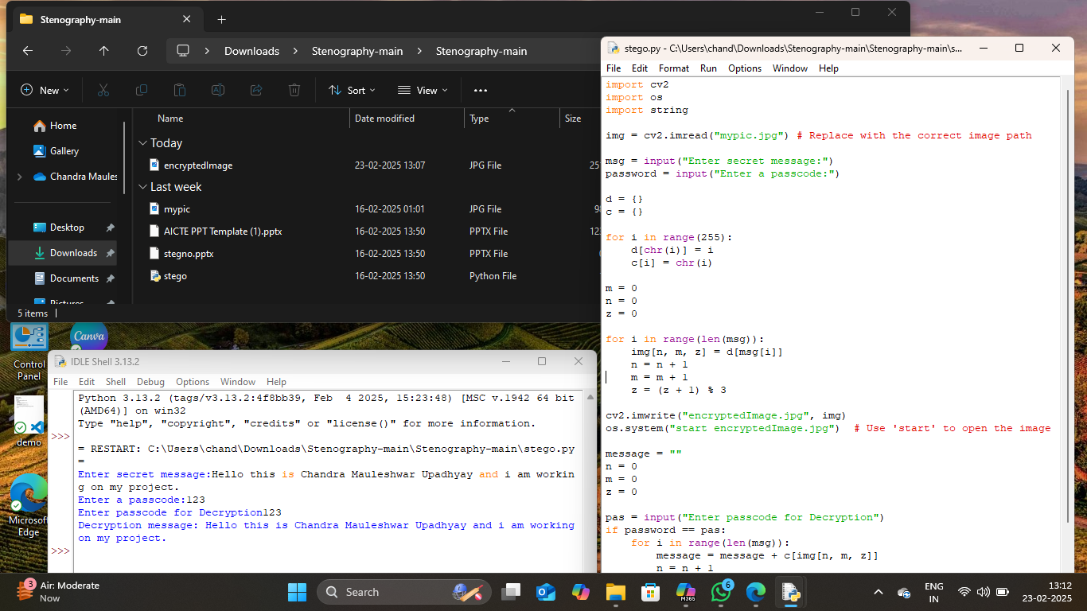
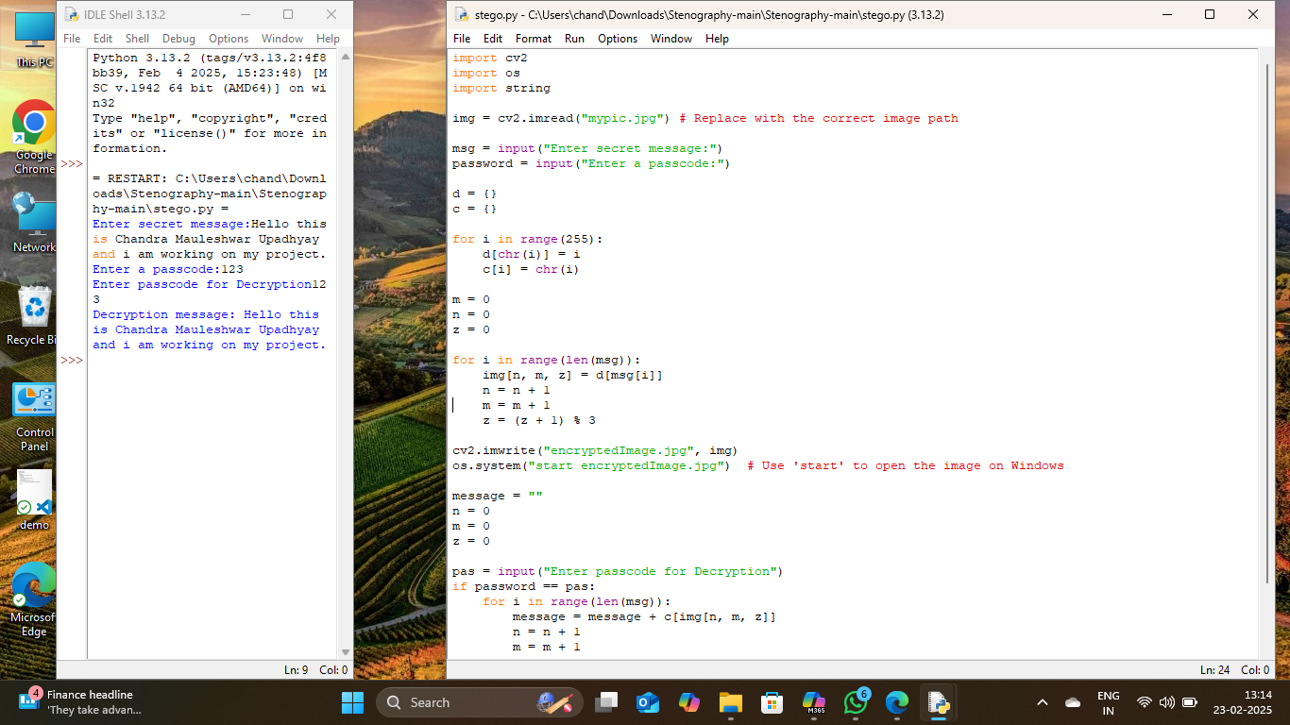

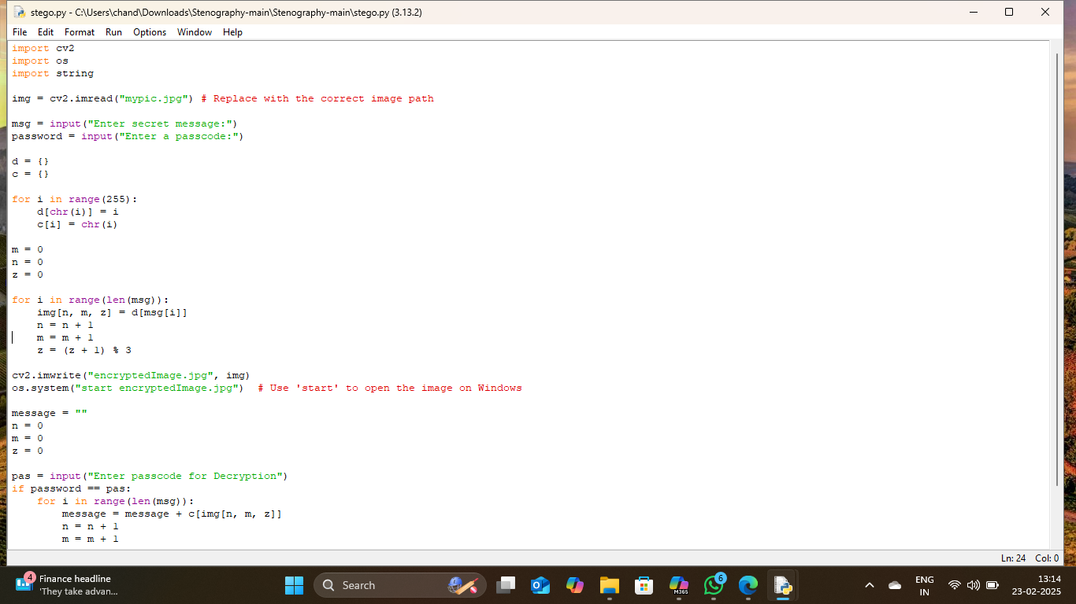
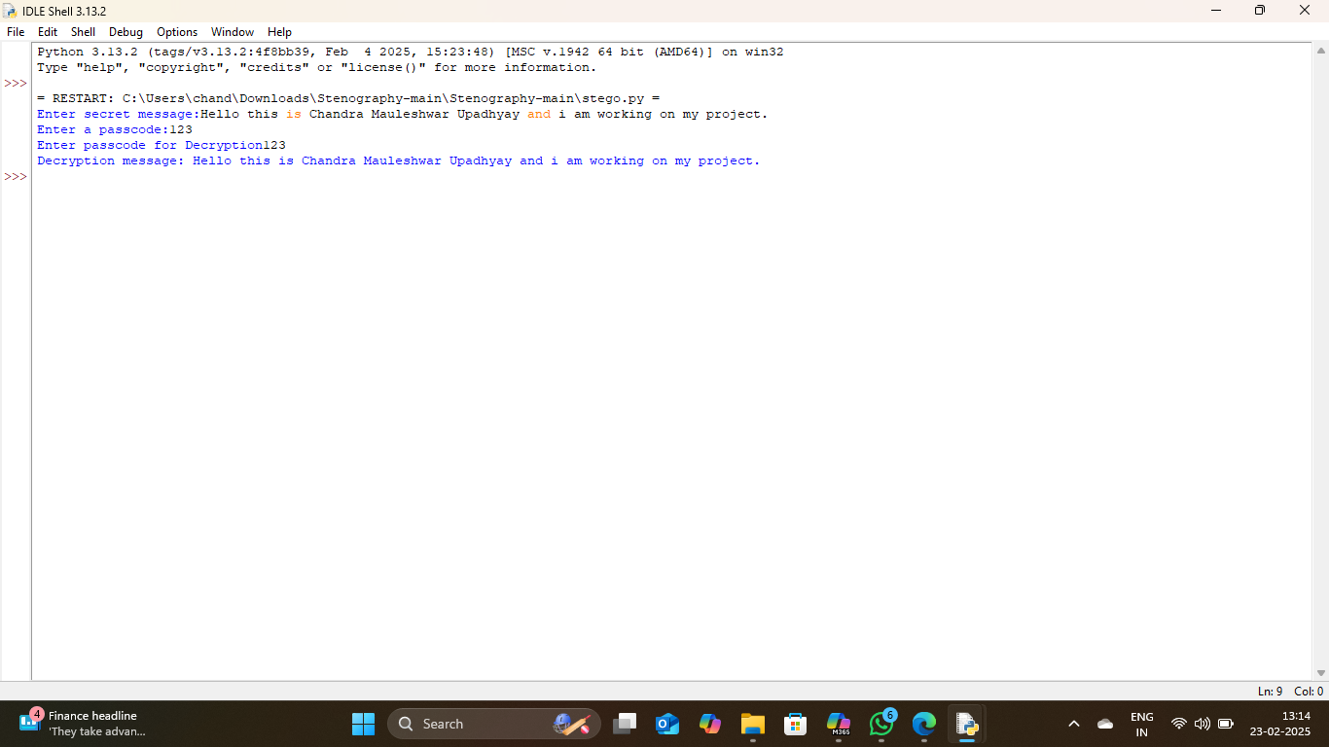
Results

Slide 8
Conclusion
In an era where data security is a major concern, this project presents an innovative and discreet method for secure communication. By leveraging image steganography with Least Significant Bit (LSB) encoding, it allows users to hide messages within images without altering their visual appearance. Unlike traditional encryption methods, this approach ensures that sensitive information remains unnoticed, reducing the risk of interception.
Additionally, password protection enhances security, ensuring only authorized users can decrypt the hidden message. This technique is highly useful for cybersecurity professionals, journalists, businesses, and individuals who require a safe, efficient, and undetectable way to share confidential data.
quality.

Slide 9
GitHub Link
https://github.com/Dharitri-Sarkar/Cyber-Security-Project.git

Slide 10
Future scope(optional)
Enhanced Encryption: Integrate stronger encryption algorithms along with steganography for added security.
Multiple File Formats: Expand support to hide messages in audio, video, and document files.
AI-Based Detection Prevention: Implement AI techniques to make hidden messages even more undetectable.
Cloud & Mobile Integration: Develop a web or mobile app for easy and secure message hiding and retrieval.
Increased Storage Capacity: Optimize algorithms to store larger messages without affecting image quality.

Slide 11
THANK YOU

